Slide 1



Aurora
Robotics
‹#›
Embedded Systems &
Software Development
WEEK 2 OF 8 · AERIAL ROBOTICS
Aurora Robotics
O. C. Kogo, O. O. Egharevba
Run into
The UNKNOWN

Slide 2
‹#›
Aurora
Robotics
AERIAL
ROBOTICS
OUTLINE
Out-line
  The Linux command line
  Version Control using Git
  What is a Drone made up of?
  Sensors
  Actuators
  Embedded Computing and Flight Controllers
Run into
The UNKNOWN

Slide 3
‹#›
Aurora
Robotics
AERIAL
ROBOTICS
OVERVIEW
Overview
  This week would be split into two parts: software development and embedded systems
  In the software development section, we would look at what programming languages are used in this field, and the language that would be used throughout this course.
  In the embedded systems section, we would look at what embedded systems as a subfield is, and the different things that make up the different kinds of drones.
Run into
The UNKNOWN
Run into
The UNKNOWN

Slide 4

‹#›
Aurora
Robotics
AERIAL
ROBOTICS
DRONE SOFTWARE DEVELOPMENT
What Programming Languages are used in Drone Development?
  Drone development is a subcategory of mobile robotics as mentioned earlier, and uses mostly the same languages.
  C/C++ are the standard for writing drone firmware.
  Drone firmware is the software running on flight controllers and onboard microcontrollers that interfaces with the drone's components, including its sensors and actuators.
  C/C++ are the standard for drone firmware due to their speed, determinism, and low-level hardware access, which allow for efficient use of limited computational resources.
Run into
The UNKNOWN

Slide 5
‹#›
Aurora
Robotics
AERIAL
ROBOTICS
Programming Languages Continued
  For higher-level tasks such as navigation, path-planning, SLAM, computer vision, etc.. Python and C++ are widely used.
  C++ is the industry standard due to its speed and determinism.
  C++ is the industry standard due to its speed and determinism.
  Python was widely adopted due to its simplicity which made it very efficient for testing out ideas and prototyping.
  Python would be used throughout this course as C++ is too bulky to be taught within the timeframe.
Run into
The UNKNOWN
Notes:
Due to this, it is becoming adopted more even in industry.
‹#›

Slide 6
‹#›
Aurora
Robotics
AERIAL
ROBOTICS
DRONE SOFTWARE DEVELOPMENT
The Linux Command Line
  Directories: these are basically folders. That's it, literally.
  Paths are 'addresses' of files and folders. They are strings of text containing the location to a directory/file.
  Think of it like your home address.
  There are 2 fundamental types of paths, absolute and relative paths.
  Absolute paths are paths started from the root.
  This means they start from the root directory containing all directories in your system.
Run into
The UNKNOWN

Slide 7
‹#›
Aurora
Robotics
AERIAL
ROBOTICS
DRONE SOFTWARE DEVELOPMENT
Linux Command Line contd.
  Relative paths are paths started from the current directory.
  The command line allows you to traverse directories on your PC, open files, read contents of a file, execute commands, write to files, create new files and directories, install software, etc.
  Some commands, like commands for installing software, require admin privileges.
  sudo is a special keyword which gives the user admin privileges for that particular command.
  While the user can give himself permanent admin privileges, this is very discouraged.
Run into
The UNKNOWN

Slide 8
‹#›
Aurora
Robotics
AERIAL
ROBOTICS
DRONE SOFTWARE DEVELOPMENT
Linux Command Line contd.
  A few key commands for navigation and editing are given below:
  cd: this stands for change directory and is used to change the current directory to the directory provided.
  touch: this is used to create a file with the name provided: touch newFile.txt
  mkdir: this stands for make directory and is used to create a new subdirectory with the path provided.
  Other commands are in the data files provided in the course.
Run into
The UNKNOWN

Slide 9
‹#›
Aurora
Robotics
AERIAL
ROBOTICS
DRONE SOFTWARE DEVELOPMENT
Version Control using Git
  Git is a distributed version control system originally developed by Linus Torvalds in 2005. It tracks changes to files and enables collaborative software development.
  Git is installed on Linux using:
  sudo apt install git
  When starting a Git repository, you first initialize the repository using git init.
Run into
The UNKNOWN

Slide 10
‹#›
Aurora
Robotics
AERIAL
ROBOTICS
VC Continued
  Secondly, to bookmark some progress or changes, you add the current directory to the staging area.
  This is an intermediary layer between your current files and the committed files.
  Thirdly, you commit the staged changes to the repository. A commit acts as a snapshot of the project at that point in time.
Run into
The UNKNOWN
Notes:
Without the –m flag, git will open a text editor in which you can type in longer notes for that commit.
‹#›

Slide 11
‹#›
Aurora
Robotics
AERIAL
ROBOTICS
DRONE SOFTWARE DEVELOPMENT
Github
  Github is a website which serves as a hub for hosting git repositories.
  This allows developers to share their code with others, collaborate on projects and contribute to open-source projects.
  After your first commit, to push your code to github, you first create a repository on github for that project.
  Secondly, you name your current branch back on your local terminal.
  You then tell git where the github repository is via ssh.
Run into
The UNKNOWN

Slide 12
‹#›
Aurora
Robotics
AERIAL
ROBOTICS
DRONE SOFTWARE DEVELOPMENT
Github Contd.
  And then push your code to the remote branch: git push –u origin main
  The next time you commit and want to push to your github, maybe after updating a feature or fixing a bug, all you have to type is: git push
  To download other people's repositories, you can use: git clone https://github.com/USERNAME/REPOSITORY.git
  When changes have been made, this command updates your local version to the most recent one on github: git pull
Run into
The UNKNOWN

Slide 13
‹#›
Aurora
Robotics
AERIAL
ROBOTICS
EMBEDDED SYSTEMS
What is a Drone made up of ?
  A drone is made up of 2 main parts: An airframe which provides physical support and its electronics.
  The airframe can designed using additive CAD or traditional manufacturing techniques.
  As for the electronics, it can be divided into 3 main classes of electrical devices: Actuators, Sensors and Embedded Computing devices.
Run into
The UNKNOWN

Slide 14
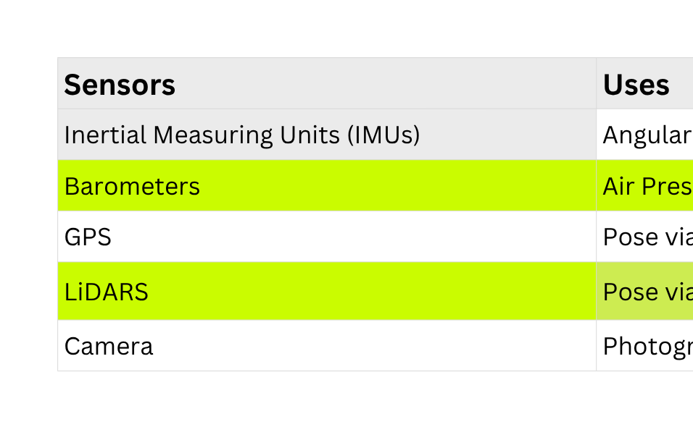
‹#›
Aurora
Robotics
AERIAL
ROBOTICS
EMBEDDED SYSTEMS
Sensors
  A sensor is a device that detects a physical quantity. 'Physical quantity' could be light, temperature, sound, a magnetic field, etc..
  Sensors use transducers to convert physical quantities into electrical signals, which may be processed internally or transmitted digitally to a microcontroller or computer.
Run into
The UNKNOWN
Notes:
Reminder that this is not an exhaustive list. Make sure to inform students.
‹#›

Slide 15
‹#›
Aurora
Robotics
AERIAL
ROBOTICS
EMBEDDED SYSTEMS
Actuators
  An actuator is a device that converts energy to mechanical work. In simpler terms, it takes in electricity and in turn translates/rotates.
  In aerial robotics, BLDC motors are very commonly used.
  BLDC stands for Brushless DC Motors.
  BLDC motors are preferred in drones mainly because they offer high power-to-weight ratio, high efficiency, high power density, and good controllability at high speeds.
Run into
The UNKNOWN

Slide 16
‹#›
Aurora
Robotics
AERIAL
ROBOTICS
EMBEDDED SYSTEMS
Embedded Computing and Flight Controllers
  Embedded computing refers to the design and implementation of computer systems that are integrated into other devices or systems.
  These computer systems are microcontrollers (Arduino, stm32), or Single Board Chips (SBCs- Raspberry pi, Jetson Nano Orin).
  Microcontrollers are compact computers that integrate a CPU, memory, and hardware peripherals on a single chip.
  In drones, flight controllers, which are special computing boards which have special software preinstalled are used extensively.
Run into
The UNKNOWN

Slide 17
‹#›
Aurora
Robotics
AERIAL
ROBOTICS
EMBEDDED SYSTEMS
Embedded Computing and Flight Controllers contd.
  Single-Board Computers (SBCs) are compact computers built on a single circuit board.
  In a typical setup, a drone would have one sbc and a flight controller.
  The SBC will make higher-level decisions (for example- path planning) and send commands to the flight controller or microcontroller.
  The flight controller will take these commands, process them and send them directly to the actuators.
  Flight Controllers also take sensor readings, process and send them up to the SBC or remote computers.
Run into
The UNKNOWN

